Slide 1
Setting up a Strategic Plan for the European RVs Operators Community:
first outcomes from the Eurofleets+ WP8 “Foresight: Legacy and Roadmap”
Giuseppe Magnifico – Olivier Lefort – Pascal Morin
giuseppe.magnifico@emso-eu.org; giuseppe.magnifico@cnr.it
Olivier.lefort@ifremer.fr
Pascal.morin@ifremer.fr

Slide 2
Wp8 main objectives
To maintain, capitalise and further optimise the legacy of the two previous FP7 grants (Eurofleets 2009-2013 and Eurofleets2 2013-2017)
To provide long-term proposals to better coordinate and optimise the utilisation of the European research fleets
To identify and agree on a long-term sustainable fleets coordination system, with a view to consolidating a strategic and coherent vision of the European Research Fleet and outlining the future research infrastructure developments
To provide/develop/set up a strategic roadmap and long-tem sustainability plan for an operational and funding model of an advanced and user-oriented Transnational Access (TA) system

Slide 3
WP8 partners
# 12 countries
#13 Research Institutions
#1 Foundation
～30% ERVO 2019 attendees

Slide 4
Session – Agenda
Time | Talk | Speaker
16:30-16:35 | Opening of the session | Giuseppe Magnifico
16:35-16:45 | Building Eurofleets Legacy | Olivier Lefort & Pascal Morin
16:45-17:00 | Towards a Strategic Plan for Eurofleets: rationale and first outcomes | Giuseppe Magnifico
17:00-17:30 | Open discussion | All

Slide 5
Building Eurofleets Legacy

Slide 6
EurofleETS 1 and 2 achievements
Networking, strategy and fleet management:
A refined definition of ship classes, whish has served as a support to establish a Database on European Research fleets, technical capacities and national Roadmaps (EF2 2017 – Consortium only),
Regarding Polar Research vessels, partly based on the work done through EF1 and EF2, ARICE FP3 Project has been launched and act now on its own side,
Scenarios for further cooperation and coordination between European Research Fleets have been drawn (EF2 WP4 D4.2 and D4.6 deliverables)

Slide 7
EurofleETS 1 and 2 achievements
Access:
Transnational Access has been the core activity of the EUROFLEETS(1) and EUROFLEETS2 project since one central aim was to provide access for the first time to European Research Vessels –RVs- for all European scientists and their partners, in particular for scientists from nations with limited, or no, access to research vessels and other marine infrastructure, on basis of scientific excellence.
EUROFLEETS projects were successful in accomplishing 8 pan-European calls and an evaluation process for ship-time and equipment-time proposals. Several documentations were produced ; they describe the definition and practical management of the calls including regional calls, and the more strategic objective which aimed to work towards a shared evaluation of European calls for ship-time.

Slide 8
EurofleETS 1 and 2 achievements
Training :
One objective of the EUROFLEETS(1) and EUROFLEETS2 projects was to contribute to the training of the next generation of European marine scientists and technicians
In this view, several actions were carried out. The proposed actions range from
the organization of specific workshops to help young scientists to write successful applications to the EUROFLEETS2 ship-time calls,
the organization of ship-based practical training courses and a pilot experiment of a Floating University,
several actions fostering the recruitment of students, young marine researchers, technicians and high-school teachers for the embarked teams of TNA funded cruises.

Slide 9
EurofleETS 1 and 2 achievements
Technical aspects :
Development of a new Large EXchangeable Instruments (LEXI) database, and full interface specifications in order to guarantee the feasibility of the exchange of equipment,
Guidelines and recommendations regarding RV eco-design, noise end vibration reduction, optimization of existing vessels,
Generic designs of multipurpose RRVs : BRV35 and RRV50 design
Joint technical research on Underwater System technologies,
Joint technical research on software and tools

Slide 10
Next Steps to a legacy
01/19
–
04/20
SWOT analysis of Eurofleets achievements and building of a strategic plan. It will be done by brainstorming sessions during teleconferences and side events, back to back with relevant European scale meetings (i.e. ERVO, OFEG, OFEG-TECH, IRSO, INMARTECH, Oceanology International).
Formulating the final SWOT. The output will provide a prioritized set of Eurofleets achievements worth to be maintained and implemented, as well as best ideas for a better coordination of the European Research Fleets.
Sustainable management of the European Research Fleet. Implementation of a permanent fleets coordination platform. Between M16 and M36, preliminary scenarios will be presented to provide an interim evaluation.
04/20
–
12/22

Slide 11
Towards a Strategic Plan for Eurofleets:
rationale and first outcomes

Slide 12
Wp8 main objectives
To maintain, capitalise and further optimise the legacy of the two previous FP7 grants (Eurofleets 2009-2013 and Eurofleets2 2013-2017)
To provide long-term proposals to better coordinate and optimise the utilisation of the European research fleets
To identify and agree on a long-term sustainable fleets coordination system, with a view to consolidating a strategic and coherent vision of the European Research Fleet and outlining the future research infrastructure developments
To provide/develop/set up a strategic roadmap and long-tem sustainability plan for an operational and funding model of an advanced and user-oriented Transnational Access (TA) system

Slide 13
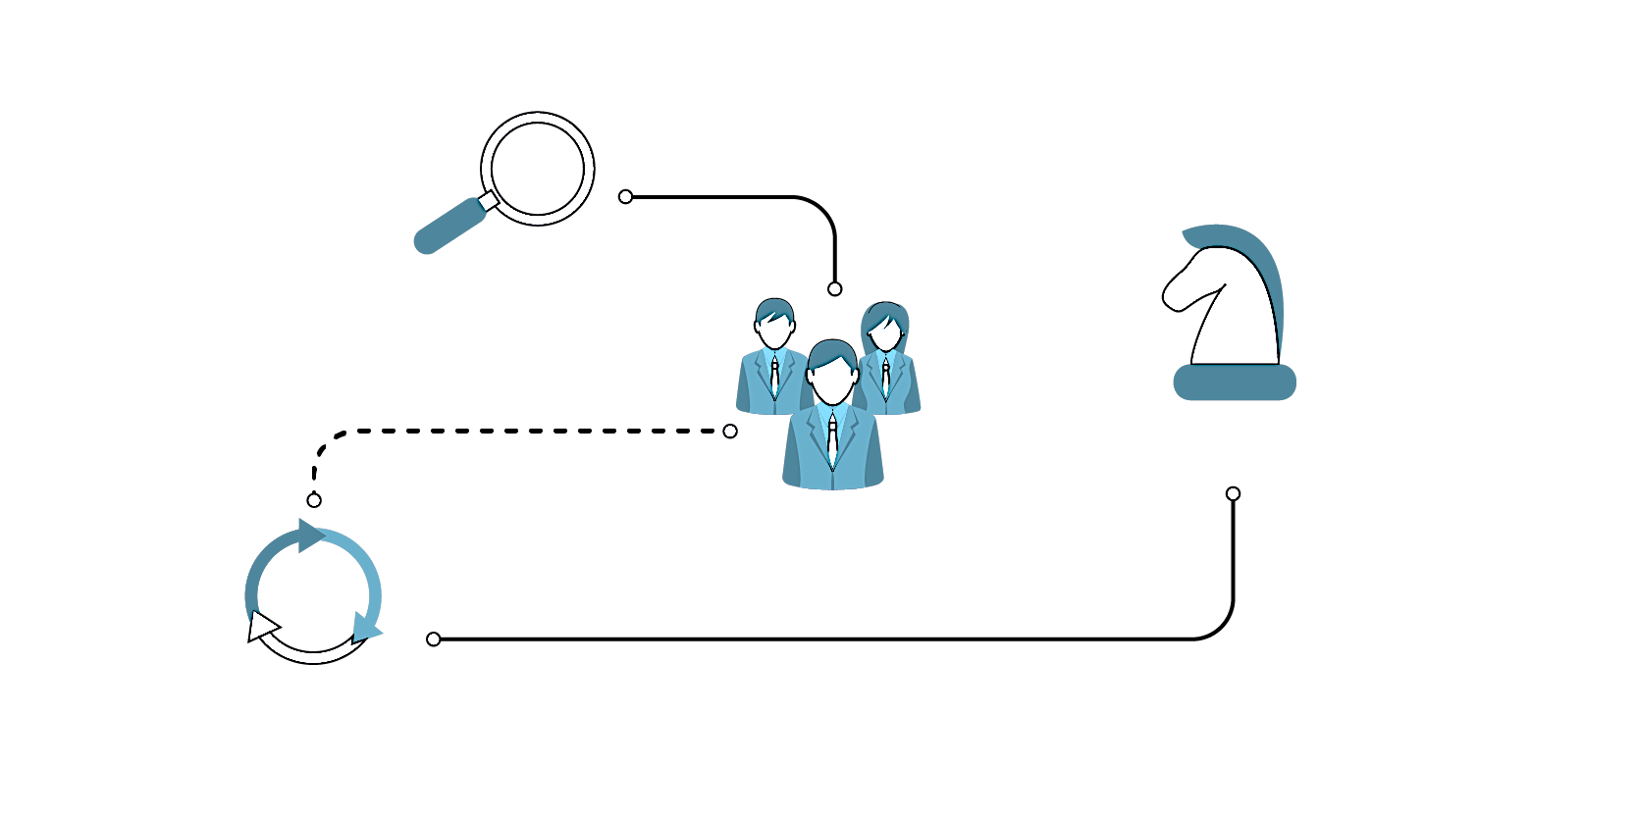
What is strategy?
Operational effectiveness
is not strategy, it means performing similar activities better than “rivals”; it is necessary, but not sufficient for competitive advantage.
Strategic positioning means performing different activities from rivals or performing similar activities in different ways:
USING DIFFERENT WAYS TO REACH CUSTOMERS
(access-based positioning)
Source: Porter Michael E., What Is Strategy? (HBR Bestseller), Oct 31, 1996, Harvard Business Review #96608
STRATEGY
SERVING NEEDS OF PARTICULAR GROUP OF CUSTOMERS
(needs-based positioning)
PRODUCING A SUBSET OF PRODUCTS/SERVICES
(variety-based positioning)
Strategy means also choosing what not to do!

Slide 14
The strategic Process
SET ASPIRATIONS
Analyze the
environment
Source: Grant, 2005
Build out the business model
Decide on positioning

Slide 15
The strategic Process
SET AND REVISIT ASPIRATIONS
Track
progress and refine or revisit
Analyze the
environment
Source: Grant, 2005
Build out the business model
Decide on positioning

Slide 16
1. Set aspirationS
Why do we exist?
Set of goals that include both the purpose of the organization, its scope of operations and the basis of its competitive advantage
Communicates the organization’s reason for being and how it aims to serve its key stakeholders
Often integrates a summation of the firm’s values
What future are
we trying to create?
Goal that is “massively inspiring, overarching and long-term”
Represents a destination that is driven by and evokes passion
A future-oriented declaration of the organization’s purpose and aspirations
Addresses what a firm wants to become
What is important to us?
Core values are what support the vision, shape the culture, and reflect what your company values
They are your company’s principles, beliefs, or philosophy of values

Slide 17
2. ANALYZE THE ENVIRONMENT PESTLE Analysis
Is a useful tool for understanding the “big picture” of the environment in which we are operating
By understanding our environment, we can take advantage of the opportunities and minimize the threats
This provides the context within more detailed planning can take place to take full advantage of the opportunities that present themselves
P
Political
The local, national and world economic impact
S
Sociological
How new and emerging technology affects the project
L
Legal
Local, national and global environmental issues
E
Economic
T
Technological
E
Environmental
The current and potential influences from political pressure
The ways in which changes in society affect the project
How local, national and global legislation affects the project

Slide 18
3. Decide on positioning S.w.o.t. Analysis
Conducting a S.W.O.T. analysis allows us to:
Understand our competitors’ strengths and weakness
Focus on how we compare to our competitors/other players
Identify what activities we need to focus on, and what activities are not necessary
Identify what activities we excel at and need to continue to support

Slide 19
4. STRATEGIC PLAN
The “game plan” for positioning the company in its chosen market arena, competing successfully, satisfying customers, and achieving good business performance
To move from where we are today to where we want to go
Important first determine our “strategic position”, i.e. where we stand today
Basic elements of strategy statement:
Objective: defines the ends that the strategy is designed to achieve within a specific time frame
Scope: is the domain of the business; the part of the business landscape in which your company will operate
Competitive advantage: is the essence of your strategy; it determines what will do differently or better than the competitors to achieve your objective

Slide 20
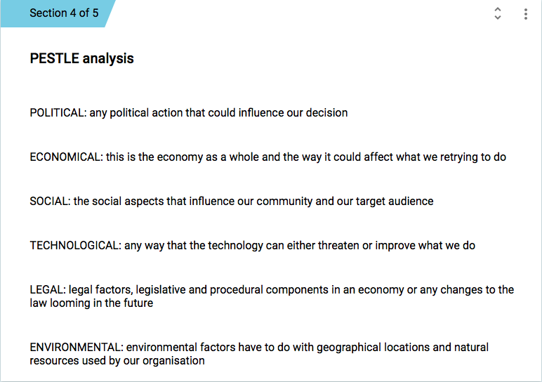
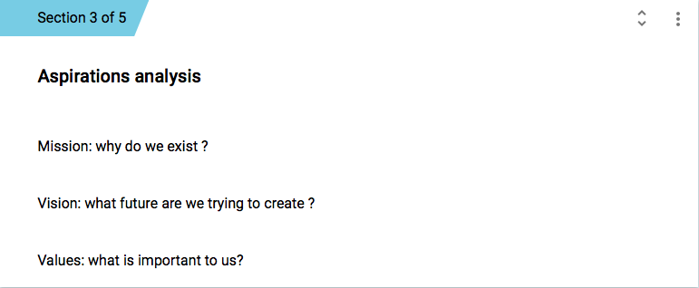
Developing Eurofleets Strategic Plan Brainstorming session Launched on 26 march 2019

Slide 21
Developing Eurofleets Strategic Plan Brainstorming session – first outcomes
MISSION
To provide, facilitate and increase open access to a pan-European sustainable, integrated and advanced fleet of research vessels and associated equipment to the EU scientific community, also from non-equipped countries,
To provide marine infrastructure services for marine research and monitoring,
To coordinate the interactions of all European research vessel operators in order to facilitate the efficient use of vessels and associated equipment for vessel users,
To develop a new generation of marine scientists and technicians through educational/training programs,
To foster the standardization of integrated services provided by vessel and equipment suppliers
To support innovation by working closely with industry in order to meet the evolving challenges of marine research, in particular, deep ocean research and exploration, data management and virtual access

Slide 22
Developing Eurofleets Strategic Plan Brainstorming session – first outcomes
VISION
to create an integrated pan-European long lasting platform to ensure a future with easy, fair, wide and efficient access to research vessels, associated equipment, services, expertise and tools for user needs with the aim of advancing Europe’s role in marine research by optimising research capacities and the use of European marine infrastructures resources coupled with improving global cooperation with international research vessel operators and industry

Slide 23
Developing Eurofleets Strategic Plan Brainstorming session – first outcomes
MAIN VALUES:
To provide the best possible access to marine infrastructure allowing scientist to get the best possible scientific results: sharing infrastructure and knowledge is key !
To keep and maintain a high quality, capable and modern research vessels/platforms and associated equipment, available to all scientists to perform excellent science
To secure permanent financing for the fleet
To exchange common practices and to share expertise in ship operational management procedures and ship design
To guarantee integrity, responsiveness to users by meeting their needs efficiently, safely, consistently and economically and preserving the environment
To guarantee interoperability, fleet integration, cooperation, collaboration, excellence, common practices, shared expertise, optimised use and resources, open access, access provision, openness and technological innovation
To raise the public awareness about the key role of research vessels to support the efficient provision of essential research services

Slide 24
Developing Eurofleets Strategic Plan Brainstorming session – first outcomes
P
Political
E
Economic
S
Sociological
T
Technological
L
Legal
E
Environmental
Lack of understanding of decision makers: make the decision makers to understand, by means of public opinion pressure if necessary, that marine research and monitoring are required even more today, and that can’t be carried out without sufficient infrastructures such as RVs
Disintegration of the EU: current European political ability could be potentially influenced by BREXIT, it could have a destabilising effect thus resulting in less cooperation between members states
EU key policy priorities/efforts towards a European world-class research infrastructures accessible to all researchers in Europe and capable to fully exploit their potential for scientific advancement and innovation

Slide 25
Developing Eurofleets Strategic Plan Brainstorming session – first outcomes
P
Political
E
Economic
S
Sociological
T
Technological
L
Legal
E
Environmental
National/European decrease of science budgets, insufficient funding for:
Investment in new RVs and/or modernization/upgrading of existing vessels
Operations, maintenance and upkeep of vessels and equipment
Need of national FIXED budgets and Trans-national funding tools such as EFs+: economic Situation of EU Member States, and crisis cycles may re-enforce the need of a common permanent platform for access to existing infrastructures
Need to socialize any economic benefit of the programs implemented by Eurofleets: in a constricting economy the program should be seen as efficient use of the European fleet
With the rise of the Blue Economy marine/maritime sciences are in the lift

Slide 26
Developing Eurofleets Strategic Plan Brainstorming session – first outcomes
P
Political
E
Economic
S
Sociological
T
Technological
L
Legal
E
Environmental
Outreach to public: the general public is yet not aware of the “So what” message, we need to pass the correct message towards the society, so it can act on our benefit as the potential voters and influencers of the decision makers
Connecting communities to the work done by the RV fleet e.g. open days, persistent presence, telepresence
European demographics need to be considered, education levels, ageing population and levels of employment.
Studying the seas and oceans starts from the availability of marine infrastructure

Slide 27
Developing Eurofleets Strategic Plan Brainstorming session – first outcomes
P
Political
E
Economic
S
Sociological
T
Technological
L
Legal
E
Environmental
Newer technologies, such as advanced AUVs and ROVs, have changed ocean science infrastructure: they will allow us to more carefully study and exploit deep-sea environments and discover the vast reserve of still unexplored natural resources
Remote sensing and automated measuring devices are a great enhancement to marine research, they are an important addition to get more spatial and temporal data, but they can't replace RVs
Greener shipping - great opportunity as RVs can act as labs for that
Some ideas that can influence the way we operate are: Principles of open data, Internet of things, Autonomous Vessel, Satellites and monitoring, Artificial intelligence and Big-Data platforms

Slide 28
Developing Eurofleets Strategic Plan Brainstorming session – first outcomes
P
Political
E
Economic
S
Sociological
T
Technological
L
Legal
E
Environmental
Lots of National requirements, International and EU Regulations/Directives, over DipClear (Diplomatic Clearance) and EIA (Environmental impact assessment) issues, EC rules in relation to state aid (providing services to industry), MARPOL, Ship Safety Standards, Ship Recycling Regulation, SOLAS, etc.
LoS (Law of the Sea) and current BBNJ (Marine biological diversity beyond areas of national jurisdiction) negotiations could have implications for RV operators and collaboration in general
Securing continuous Open Access to all data collected by EF+ projects

Slide 29
Developing Eurofleets Strategic Plan Brainstorming session – first outcomes
P
Political
E
Economic
S
Sociological
T
Technological
L
Legal
E
Environmental
Sustainable, Clean and Healthy Oceans
Fuel, carbon footprint, operations in arctic, emissions, right vessel in the right place, no waste
Ships need to be as environmental friendly as possible: the environmental impact of shipping includes air pollution, water pollution, acoustic, and oil pollution; ships are responsible for more than 18 per cent of some air pollutants
Innovation around greening of ships should be number 1 priority (Green Ship of the Future - https://greenship.org/)

Slide 30
Developing Eurofleets Strategic Plan Brainstorming session – first outcomes
S
W
Advanced community with a high degree of coordination, established reputation and networking, attained through the two previous FP7 grants, but also ERVO, IRSO, OFEG, EurOcean, EMB/ERVO WG on ERVs, etc.
Multidisciplinary, intersectoral and international consortium, combining expertise and knowledge from multiple developers and operators in the Marine environment/ecosystem/sector
Access to state-of-the-art vessels and equipment and highly skilled personnel
Fragmentation and often duplication of effort, and inefficiencies in both financial and ecological terms in the operation of these costly RIs
Dispersed community, no endured formal structure to build on our strengths, lack of a common vision, we are not yet “One Voice”
National over European/community interests, different agendas of the members states, different agendas inside the consortium
Failure to acknowledge that there are competitors to RV operators for some operations e.g. satellite community
WEAKNESSES
STRENGTHS
O
T
Provide more efficient service, vessels and fleet can be flagships, new technologies like telepresence can improve our outreach and visibility
Innovation into reducing POB (Person on Board) and fuel footprint, platform base for new autonomous
Much demand for multi-disciplinary and collaborative use of vessels
Grow public interest in environment problems
Increasing interest in collaborative methods for research from both academia and industry
Implementation of EOOS and ESFRI structures like EMSO, ICOS, LifeWatch, EMBRC
Insufficient funding for investment in new RVs and/or modernization/upgrading of existing ones, operations, maintenance and upkeep of vessels and equipment
Changing political focus across each member country can lead to uncertainty of funding for the long term
Diversity in national capacity, differences in ways of RV operations, national sentiments and interests
Lack of long-term vision and political strategy for a sustainable RV programme
Not innovating as fast as single autonomous equipment
THREATS
OPPORTUNITIES

Slide 31
Developing Eurofleets Strategic Plan Brainstorming session – first outcomes
S
W
Advanced community with a high degree of coordination, established reputation and networking, attained through the two previous FP7 grants, but also ERVO, IRSO, OFEG, EurOcean, EMB/ERVO WG on ERVs, etc.
Multidisciplinary, intersectoral and international consortium, combining expertise and knowledge from multiple developers and operators in the Marine environment/ecosystem/sector
Access to state-of-the-art vessels and equipment and highly skilled personnel
Fragmentation and often duplication of effort, and inefficiencies in both financial and ecological terms in the operation of these costly RIs
Dispersed community, no endured formal structure to build on our strengths, lack of a common vision, we are not yet “One Voice”
National over European/community interests, different agendas of the members states, different agendas inside the consortium
Failure to acknowledge that there are competitors to RV operators for some operations e.g. satellite community
WEAKNESSES
STRENGTHS
O
T
Provide more efficient service, vessels and fleet can be flagships, new technologies like telepresence can improve our outreach and visibility
Innovation into reducing POB (Person on Board) and fuel footprint, platform base for new autonomous
Much demand for multi-disciplinary and collaborative use of vessels
Grow public interest in environment problems
Increasing interest in collaborative methods for research from both academia and industry
Implementation of EOOS and ESFRI structures like EMSO, ICOS, LifeWatch, EMBRC
Insufficient funding for investment in new RVs and/or modernization/upgrading of existing ones, operations, maintenance and upkeep of vessels and equipment
Changing political focus across each member country can lead to uncertainty of funding for the long term
Diversity in national capacity, differences in ways of RV operations, national sentiments and interests
Lack of long-term vision and political strategy for a sustainable RV programme
Not innovating as fast as single autonomous equipment
THREATS
OPPORTUNITIES

Slide 32
Developing Eurofleets Strategic Plan Brainstorming session – first outcomes
S
W
Advanced community with a high degree of coordination, established reputation and networking, attained through the two previous FP7 grants, but also ERVO, IRSO, OFEG, EurOcean, EMB/ERVO WG on ERVs, etc.
Multidisciplinary, intersectoral and international consortium, combining expertise and knowledge from multiple developers and operators in the Marine environment/ecosystem/sector
Access to state-of-the-art vessels and equipment and highly skilled personnel
Fragmentation and often duplication of effort, and inefficiencies in both financial and ecological terms in the operation of these costly RIs
Dispersed community, no endured formal structure to build on our strengths, lack of a common vision, we are not yet “One Voice”
National over European/community interests, different agendas of the members states, different agendas inside the consortium
Failure to acknowledge that there are competitors to RV operators for some operations e.g. satellite community
WEAKNESSES
STRENGTHS
O
T
Provide more efficient service, vessels and fleet can be flagships, new technologies like telepresence can improve our outreach and visibility
Innovation into reducing POB (Person on Board) and fuel footprint, platform base for new autonomous
Much demand for multi-disciplinary and collaborative use of vessels
Grow public interest in environment problems
Increasing interest in collaborative methods for research from both academia and industry
Implementation of EOOS and ESFRI structures like EMSO, ICOS, LifeWatch, EMBRC
Insufficient funding for investment in new RVs and/or modernization/upgrading of existing ones, operations, maintenance and upkeep of vessels and equipment
Changing political focus across each member country can lead to uncertainty of funding for the long term
Diversity in national capacity, differences in ways of RV operations, national sentiments and interests
Lack of long-term vision and political strategy for a sustainable RV programme
Not innovating as fast as single autonomous equipment
THREATS
OPPORTUNITIES

Slide 33
Developing Eurofleets Strategic Plan Brainstorming session – first outcomes
S
W
Advanced community with a high degree of coordination, established reputation and networking, attained through the two previous FP7 grants, but also ERVO, IRSO, OFEG, EurOcean, EMB/ERVO WG on ERVs, etc.
Multidisciplinary, intersectoral and international consortium, combining expertise and knowledge from multiple developers and operators in the Marine environment/ecosystem/sector
Access to state-of-the-art vessels and equipment and highly skilled personnel
Fragmentation and often duplication of effort, and inefficiencies in both financial and ecological terms in the operation of these costly RIs
Dispersed community, no endured formal structure to build on our strengths, lack of a common vision, we are not yet “One Voice”
National over European/community interests, different agendas of the members states, different agendas inside the consortium
Failure to acknowledge that there are competitors to RV operators for some operations e.g. satellite community
WEAKNESSES
STRENGTHS
O
T
Provide more efficient service, vessels and fleet can be flagships, new technologies like telepresence can improve our outreach and visibility
Innovation into reducing POB (Person on Board) and fuel footprint, platform base for new autonomous
Much demand for multi-disciplinary and collaborative use of vessels
Grow public interest in environment problems
Increasing interest in collaborative methods for research from both academia and industry
Implementation of EOOS and ESFRI structures like EMSO, ICOS, LifeWatch, EMBRC
Insufficient funding for investment in new RVs and/or modernization/upgrading of existing ones, operations, maintenance and upkeep of vessels and equipment
Changing political focus across each member country can lead to uncertainty of funding for the long term
Diversity in national capacity, differences in ways of RV operations, national sentiments and interests
Lack of long-term vision and political strategy for a sustainable RV programme
Not innovating as fast as single autonomous equipment
THREATS
OPPORTUNITIES

Slide 34
Developing Eurofleets Strategic Plan Next steps
Brainstorming session - 2nd round
Consensus analysis/level of agreement within EFs+ consortium and ERVO Group
First survey outcomes at:
OceanObs’19 conference (September 16-20 2019, Honolulu)
32nd IRSO meeting (October 8-10 2019, Tasmania, Australia)
Half a day/1-day WP8 Workshop (mid/end November 2019, Rome/Italy? Other proposals? Side-event held back-to-back with other relevant international/European events or EFs+ meetings, WP5 for Stakeholder engagement?)
Final outcomes at the next EFs+ General Assembly (February/March 2020), along with results from Task 8.1 “Feasibility study toward a long-term TA system of Research Vessels” and Task 8.2 “Building Eurofleets legacy”

Slide 35
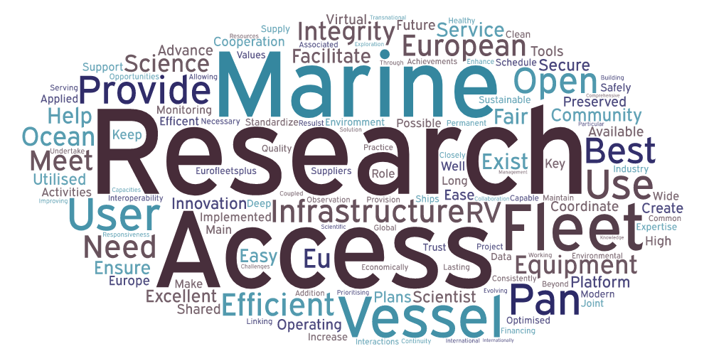
Thanks for your attention!

